Slide 1

How Data Science & AI Will Shape 2025-2026
Demo Session
Starting in few mins …

Slide 2


According to a report from the World Economic Forum, while AI and robotics will displace 85 million jobs by 2025-2026, they're also projected to create 97 million new roles in areas like AI development, data science, and human-AI collaboration.
In the latest McKinsey Global Survey on AI, 65 percent of respondents report that their organizations are regularly using AI, nearly double the percentage from our previous survey just ten months ago.

Slide 3
AI & DATA SCIENCE CARRIER PATHWAYS IN 2025-2026
Entry-Level Roles: Data Analyst,Junior Data Scientist,AI Intern,Research Assistant.
Mid-Level Roles: Machine Learning Engineer,Data Scientist,Business Intelligence Analyst,AI Consultant.
Senior Roles: Lead Data Scientist,AI Researcher,AI Product Manager,Chief Data Officer (CDO).
Emerging Opportunities: With AI applications growing in specialized sectors , emerging roles may include AI-powered healthcare consultant ,AI driven marketing strategist.

Slide 4
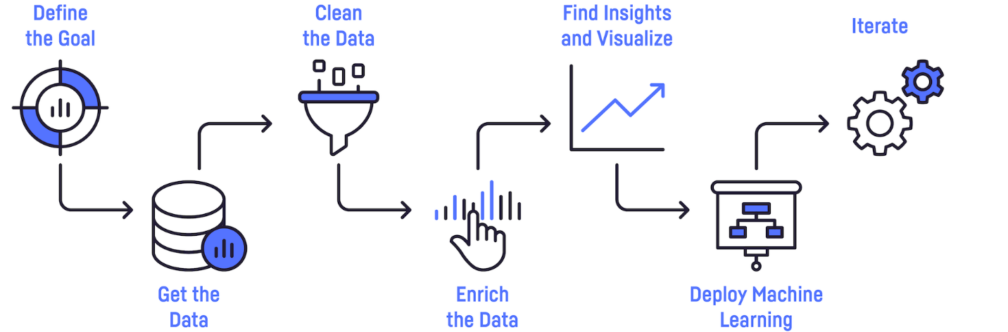




Business Leader /
Domain Experts
Data Engineer
Data Scientist
ML Engineer
Data Scientist

Slide 5
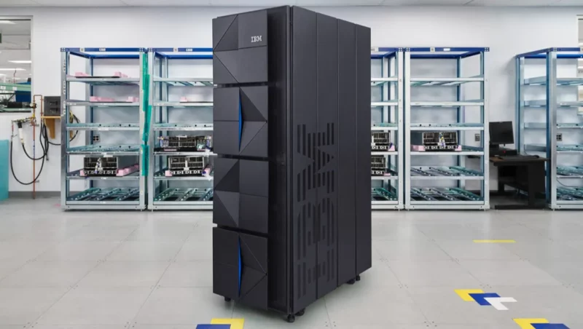

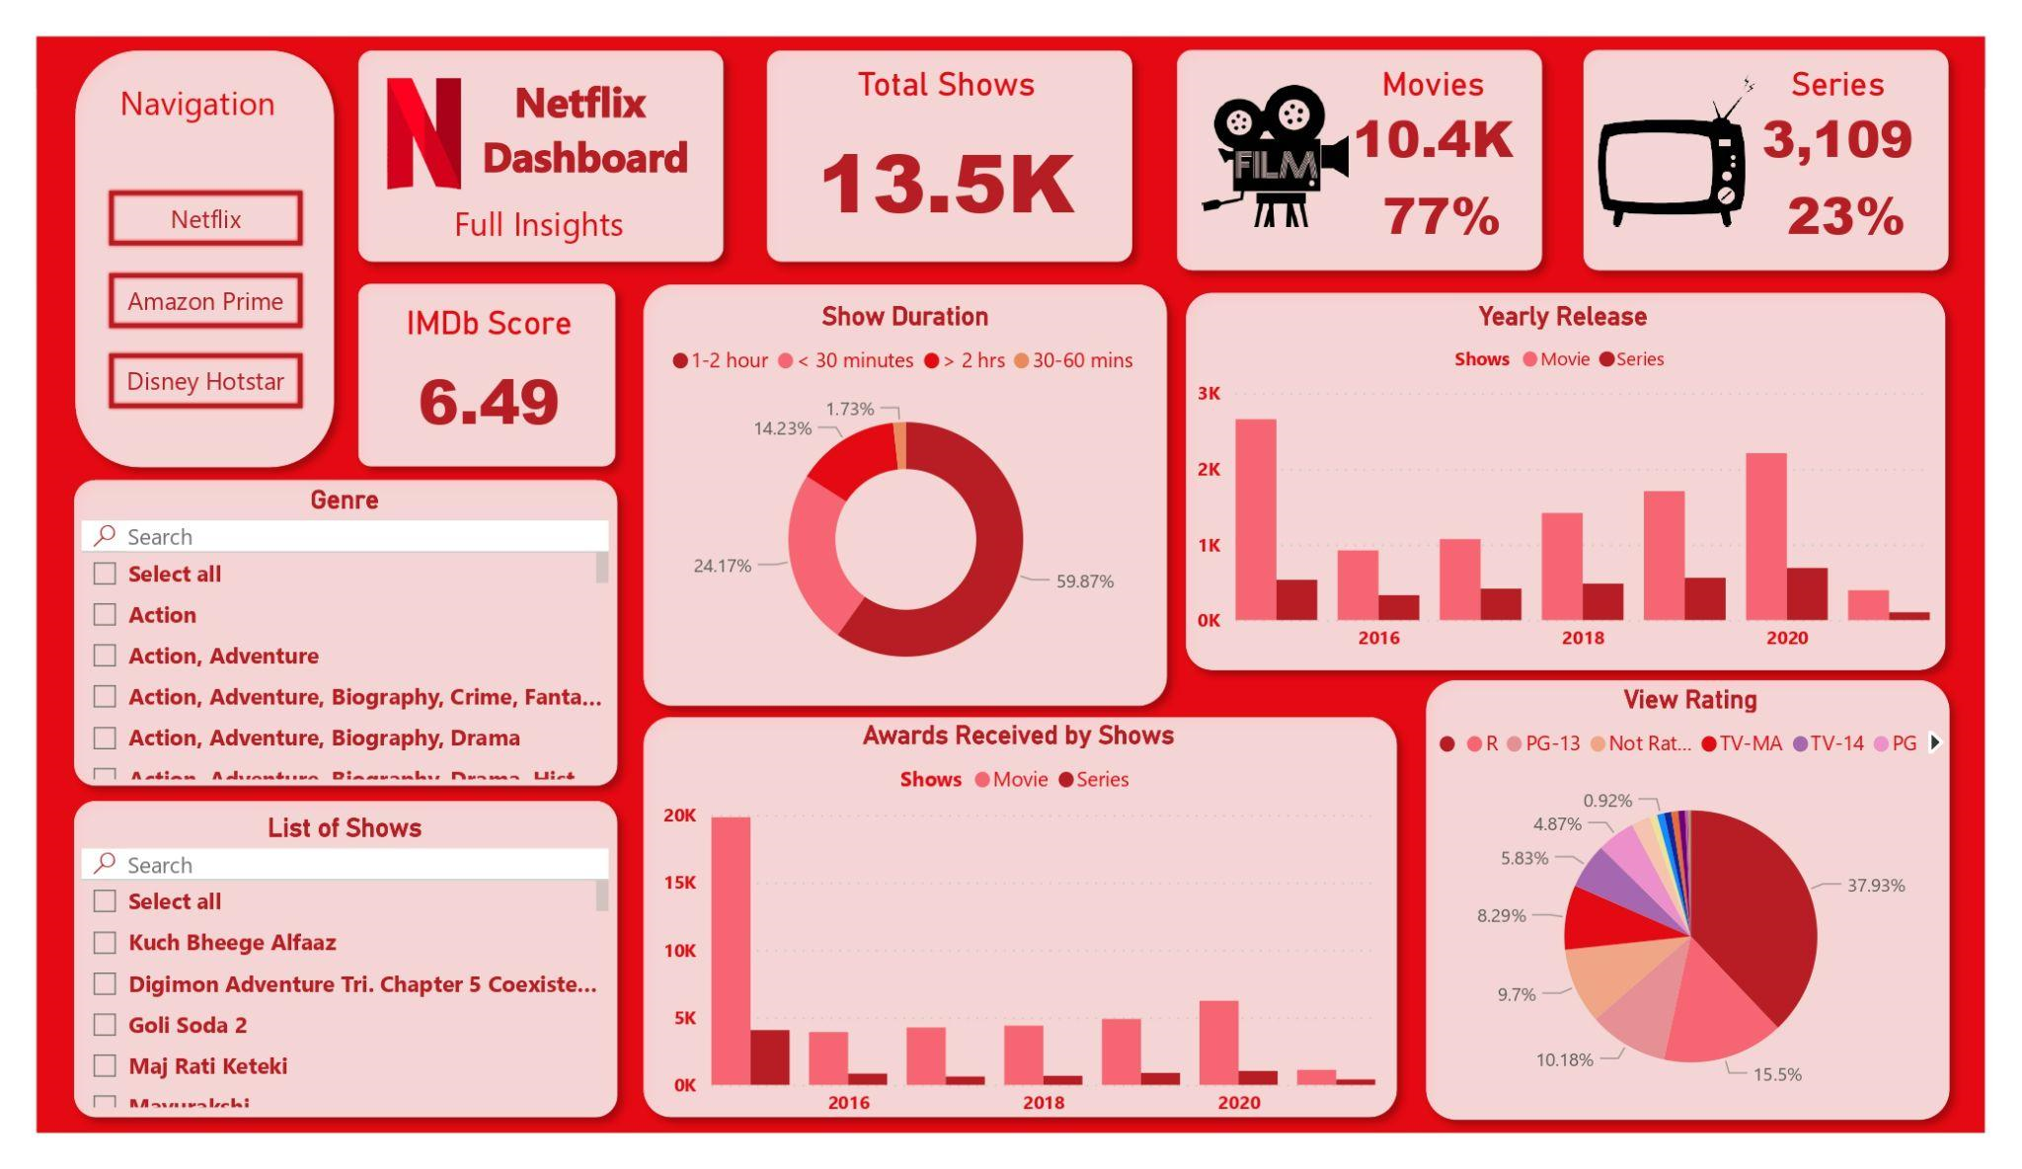
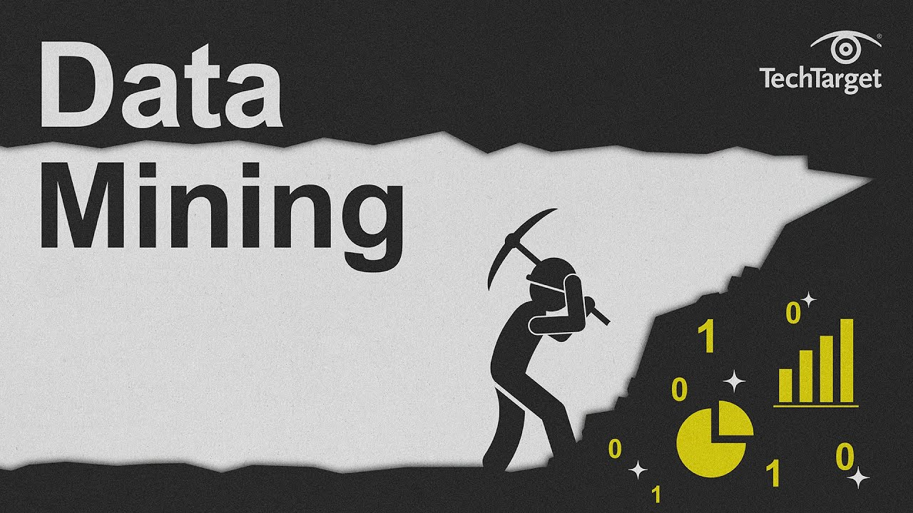

EVOLUTION OF DATA SCIENCE

Slide 6
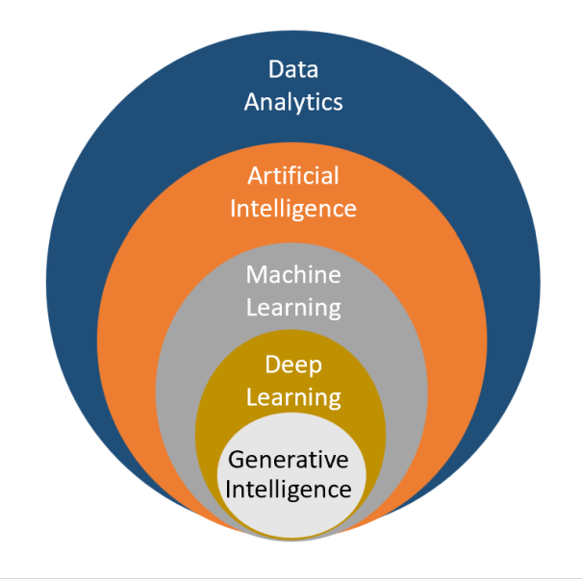
Term | Example | Explanation
AI | Virtual assistants like Siri or Alexa | Broad field creating systems that mimic human intelligence.
Data Science | Analyzing sales data to determine customer trends | Collects and analyzes data to gain insights and make decisions.
ML | Email spam filters that learn from user feedback | Subset of AI that uses data to learn and improve without explicit programming.
DL | Image recognition systems like Google Photos | Subset of ML using neural networks to learn from large amounts of data.
Generative AI | Chatbots that create human-like text or art (e.g., GPT models) | AI that generates new content based on learned patterns from data.

Slide 7
Analogy of ML learning approach

Slide 8


Employee Attrition Prediction

Slide 9


Machine Learning Use Case
Amazon Return Policy Exploitation

Slide 10

Retail
Machine Learning in Retail
what to stock, how much to buy, what products to suggest to repeat customers. But doing more with that data using machine learning is just what retailers need to really succeed in the current market.
http://www.mckinsey.com/business-functions/mckinsey-analytics/our-insights/the-age-of-analytics-competing-in-a-data-driven-world
https://www.forbes.com/sites/garydrenik/2023/08/22/retail-redefined-ais-affinity-for-personalized-engagement/?sh=6065b4537a3a

Slide 11

Financial Services - American Express
American Express processes $1 trillion in transaction and has 110 million AmEx cards in operation.
They rely heavily on data analytics and machine learning algorithms to help detect fraud in near real time, therefore saving millions in losses.
Additionally, AmEx is leveraging its data flows to develop apps that can connect a cardholder with products or services and special offers.
They are also giving merchants online business trend analysis and industry peer benchmarking.

Slide 12

Manufacturing - Volvo
Cars are increasingly connected and generate data that can be used in a number of ways.
Volvo uses data to help predict when parts would fail or when vehicles need servicing, uphold its impressive safety record by monitoring vehicle performance during hazardous situations and to improve driver and passenger convenience.
Volvo is also conducting its own research and development on autonomous vehicles.

Slide 13
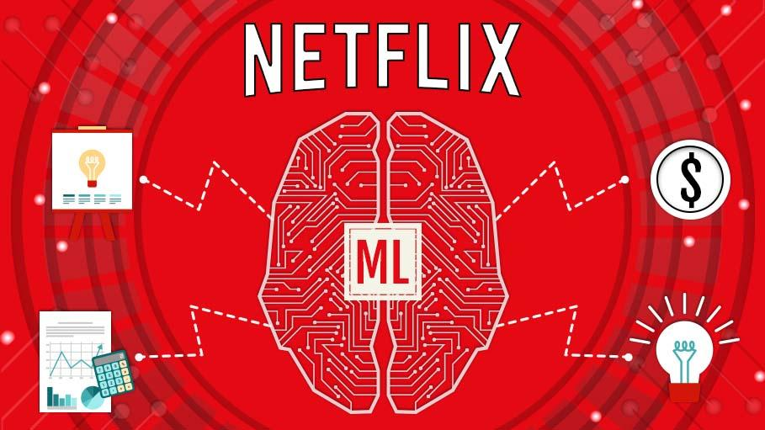
Media - Netflix
Big data analytics is helping Netflix predict what its customers will enjoy watching.
They are also increasingly a content creator, not just a distributor, and use data to drive what content it will invest in creating.
Due to the confidence they have in the data findings, they are willing to buck convention and commission multiple seasons of a new show rather than just a pilot episode.

Slide 14

Health Care
University of Oxford researchers created an AI system that scanned routine medical data to predict risk of cardiac events in the next 10 years.
AI Predict Heart Attack
Better Than Doctors
https://www.theguardian.com/society/2023/nov/13/ai-could-predict-heart-attack-risk-up-to-10-years-in-the-future-finds-oxford-study
https://www.ox.ac.uk/news/2023-11-13-ai-tool-could-help-thousands-avoid-fatal-heart-attacks

Slide 15

AI will fight challenging diseases
We'll Soon Trust AI More Than Doctors
From Diagnosis to Treatment

Slide 16


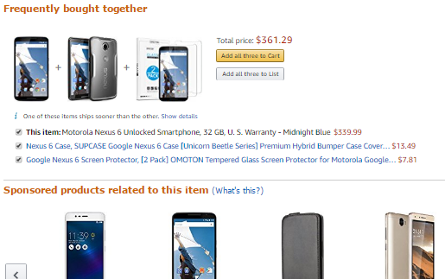

Some more..
HR Analytics
Facial Recognition
Recommendations
Skin Cancer Deduction

Slide 17

Consumer goods - Barbie
Using natural language processing, machine learning and advanced analytics, Hello Barbie listens and responds to a child.
A microphone on Barbie’s necklace can record and transmit to the servers at ToyTalk.
There, the recording is analyzed to determine the appropriate response from 8,000 lines of dialogue.
Servers transmit the correct response back to Barbie in under a second so she can respond to the child.

Slide 18






ACCOLADES
7 Years
Delivering excellence
100,000+
Learners Worldwide
20+
Partnerships with Universities & Boards
CII Partner for AI Training
DataMites® chosen as a partner by CII for providing AI training C-level executives MNCs in India
NASSCOM Partner
to align course curriculum with industry requirements. Assess skills and certify learners.
Awarded Top 10
Best Institute in 2018 and 2021
Best Training Methodology
Quoted by industry veteran Mr. Lakshmi Narayanan, the Ex. CEO and president of Cognizant

Slide 19
Course Bundles
Certified Data Scientist (CDS)
Certified Data Analyst (CDA)
ORDER | COURSE | CODE | LEARNING HRS. | WEEKS
1 | Data Science Foundation | CDM-DSF-112 | 20 | 1
2 | Python Foundation | CDM-PYF-110 | 40 | 2
3 | Statistics Essentials | CDM-STA-139 | 20 | 1
4 | Machine Learning Associate | CDM-MLA-130 | 40 | 2
5 | Machine Learning Expert | CDM-MLE-113 | 40 | 2
6 | Advanced Data Science | CDM-ADS-114 | 40 | 2
7 | Database: SQL and MongoDB | CDM-DBM-120 | 40 | 2
8 | Version Control with Git | CDM-GIT-115 | 20 | 1
9 | Big Data Foundation | CDM-BDF-117 | 20 | 1
10 | Certified Business Intelligence(BI) Analyst | CDM-BIA-119 | 20 | 1
Duration | 8 months | Learning Hours | 300 | 15
Add-Ons | Internship and Placements | Project and Intern (Hrs) | 400
ORDER | COURSE | CODE | LEARNING HRS. | WEEKS
1 | Data Analysis Foundation | CDM-DAF-131 | 20 | 1
2 | Statistics Essentials | CDM-STA-139 | 20 | 1
3 | Data Analysis Associate | CDM-DAA-137 | 20 | 1
4 | Advanced Data Analytics | CDM-ADA-134 | 40 | 2
5 | Predictive Analytics with Machine Learning | CDM-PAM-140 | 40 | 2
6 | Database: SQL and MongoDB | CDM-DBM-120 | 40 | 2
8 | Version Control with Git | CDM-GIT-115 | 20 | 1
7 | Big Data Foundation | CDM-BDF-117 | 20 | 1
9 | Python Foundation | CDM-PYF-110 | 40 | 2
10 | Certified Business Intelligence(BI) Analyst | CDM-BIA-119 | 20 | 1
Duration | 5 months | Learning Hours | 220 | 11
Add-Ons | Internship and Placements | Project and Intern (Hrs) | 200

Slide 20
AI Engineer (AIE) (CDM-AIE-BUN-071)
ORDER | COURSE | CODE |  | LEARNING HRS.
1 | Data Science Foundation | CDM-DSF-112 | CORE | 20
2 | Python Foundation | CDM-PYF-110 | CORE | 40
3 | Statistics Essentials | CDM-STA-139 | CORE | 20
4 | Machine Learning Associate | CDM-MLA-130 | CORE | 40
5 | Machine Learning Expert | CDM-MLE-113 | CORE | 40
6 | Advanced Data Science | CDM-ADS-114 | CORE | 40
7 | Database: SQL and MongoDB | CDM-DBM-120 | CORE | 40
8 | Version Control with Git | CDM-GIT-115 | CORE | 20
9 | Big Data Foundation | CDM-BDF-117 | CORE | 20
10 | Certified Business Intelligence(BI) Analyst | CDM-BIA-119 | CORE | 20
11 | AI Foundation | CDM-AIF-128 | CORE | 20
12 | AI Expert | CDM-AIE-124 | CORE | 80
Duration | 10 months |  | Learning Hours | 400
Add-Ons | Internship and Placements |  | Project and Intern (Hrs) | 30

Slide 21

Proven Structured Learning Approach
3-Phase Learning
PHASE -3
INTERNSHIP & PROJECTS
4-5 MONTHS
PHASE -2
LIVE TRAINING
3-6 MONTHS
Certifications
IABAC Global
NASSCOM
Job Ready Program
4-5 Month project mentoring
internship
20 capstone projects
1 client /Live project
Experience certificate
PHASE -1
PRE-COURSE STUDY
2 WEEKS
Live Training
20 hour a week
Comprehensive syllabus
Hands-on Projects
Expert trainers and mentors
Pre course Self-Study
High Quality Videos with easy learning approach.

Slide 22
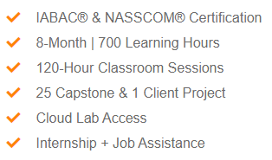
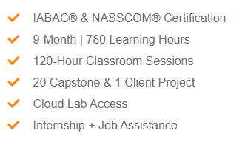
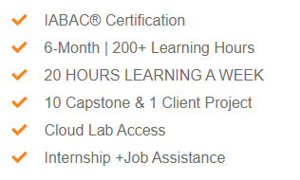
SPOT REGISTRATION OFFER PRICE
Data Science
Classroom: INR 64,451
Online: INR 59,451
(All inc)
AI Engineer
Classroom: INR 86,900
Online: INR 81,900
(All inc)
Data Analyst
Classroom: INR 60,451
Online: INR 55,451
(All inc)

Slide 23
Q&A

